Slide 1
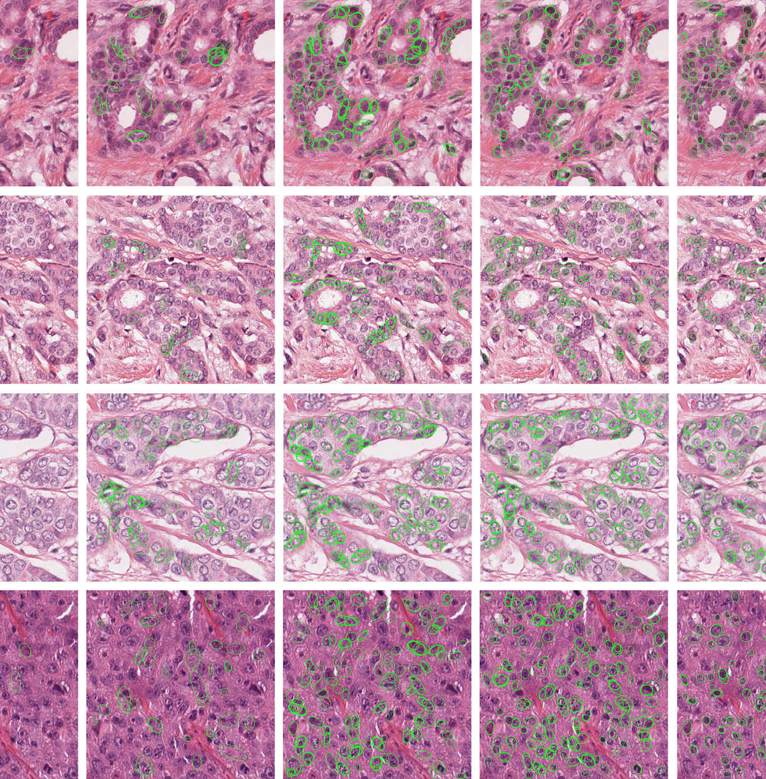
using ml to Predict Breast Tissue Tumor Malignancy
John Kearns

Slide 2
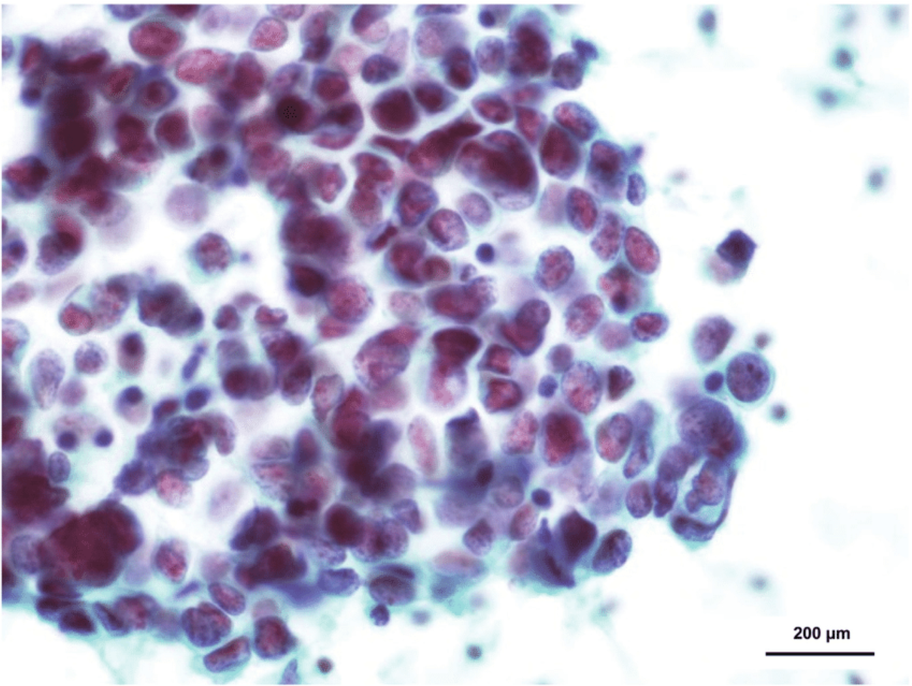
INTRODUCTION TO the data
The dataset used for the machine learning models in this project comes from a 1995 paper by researchers at the University of Wisconsin-Madison.
https://www.kaggle.com/uciml/breast-cancer-wisconsin-data
The study aggregated anonymized breast tumor biopsy samples and reported values physical characteristics of nuclei in digitized images of the cells in the tumor.
The values were grouped by mean, standard error ‘worst’ (avg. of three largest observations).
Example) Nuclei shown in a fine-needle aspirate derived sample after staining

Slide 3
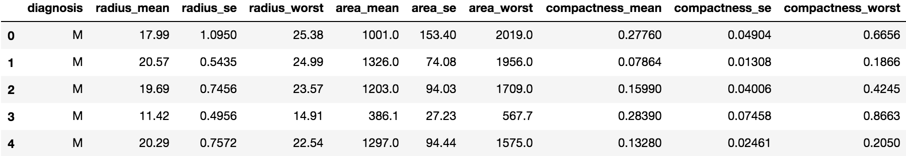
Data features
The following are the measured physical features of the nuclei and their relevant calculations
radius (mean of distances from center to points on the perimeter)
texture (standard deviation of gray-scale values)
perimeter
area
smoothness (local variation in radius lengths)
compactness ((perimeter² / area) - 1.0)
concavity (severity of concave portions of the contour)
concave points (number of concave portions of the contour)
symmetry
fractal dimension ("coastline approximation" - 1.0)
From the data) “Diagnosis” and three feature types: “radius”, ”area”, and “compactness” shown in their distinct measurement categories.

Slide 4
modeling approach
EDA
Classification
PCA
Scaling
Regression
Pre-Processing and Exploratory Data Analysis (EDA)
The goal of the pre-processing and EDA phase was to clean the data to the extent necessary and look for any relevant statistical trends (correlation, skew, bias, etc.)
Scaling
The goal of scaling was to transform the data such that features with much larger or smaller value scales wouldn’t affect the interpretation of the data by obscuring the weight of other feature sets.
Logistic Regression Model
The goal of building a Logistic Regression model was to develop a supervised ML algorithm that could accurately predict whether the tumor sample was malignant or benign. This was achieved by dividing the data into training and test sets, and using the training set to make predictions on the testing set.

Slide 5
model approach
EDA
Classification
PCA
Scaling
Regression
‘RandomForestClassifier’ Classification
The goal of implementing a classification model using the RandomForestClassifier was to use RCF’s ‘feature_importance’ function from sklearn. This function indicates which feature in the data contributed most to the classification ’malignant’ or ‘benign.’
Principal Component Analysis (PCA)
The goal of implementing a PCA model was to determine how many principal component vectors were responsible for generating the greatest percentage of overall variance in the data.
Dimensionality Reduction
The result of PCA shows whether all the features in the data are required to generate an accurate ML algorithm. I tested the PCA model with a decreasing number of dimensions to observe the effect on prediction accuracy.

Slide 6
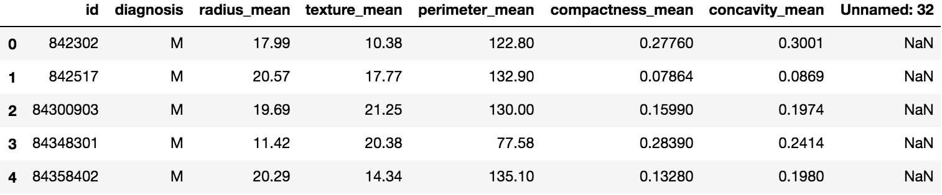
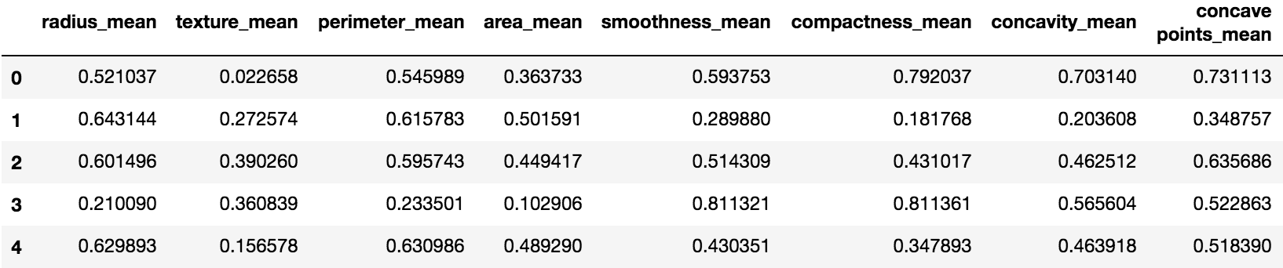
Pre-processing
The first step for pre-processing was to clean the data. Since the dataset was anonymized, the ‘id’ column served no purpose and I removed the nonsensical column at the end. Next, I applied a MinMaxScaler() to scale the data appropriately for modeling.
From the data) Cleaned and scaled after pre-processing

Slide 7
Exploratory data analysis
There were two aspects that I wanted to explore most during the EDA phase: correlation, and variance between the ‘mean’ and ‘worst’ categories. Correlation has the potential to show determinants of malignancy, while category variance could identify a value threshold at which a tumor could correctly classified.
Correlation
Using seaborn I generated two two cluster maps, one for the ‘means’ columns and one for the ‘worst’ columns to observe correlation. For both categories radius, perimeter, area, compactness, concavity, and concave_points showed higher degrees of correlation.
Variance
After applying MinMaxScaler(), I generated used matplotlib to generate a boxplot of each set (‘means’ , ’worst’) of columns next to each other to see how dramatic the distributions were between categories, and if any feature stood out.

Slide 8
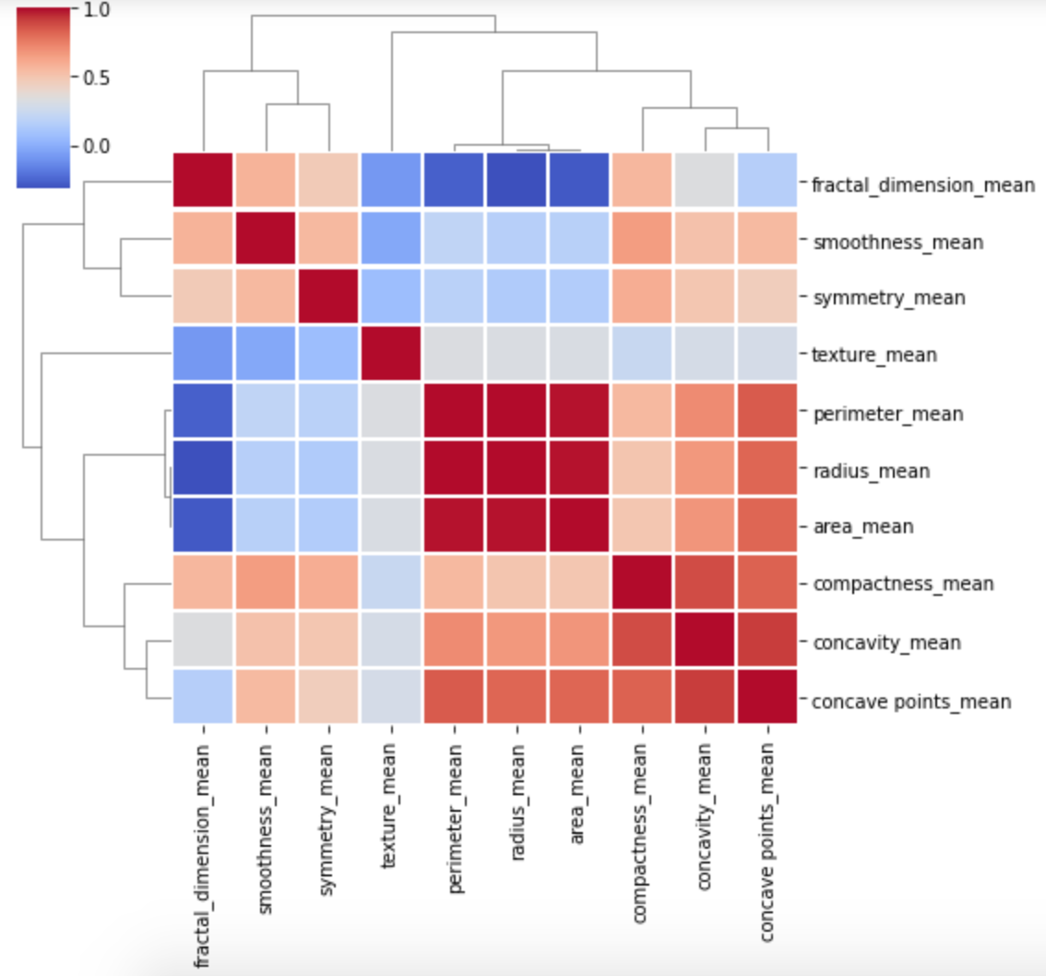
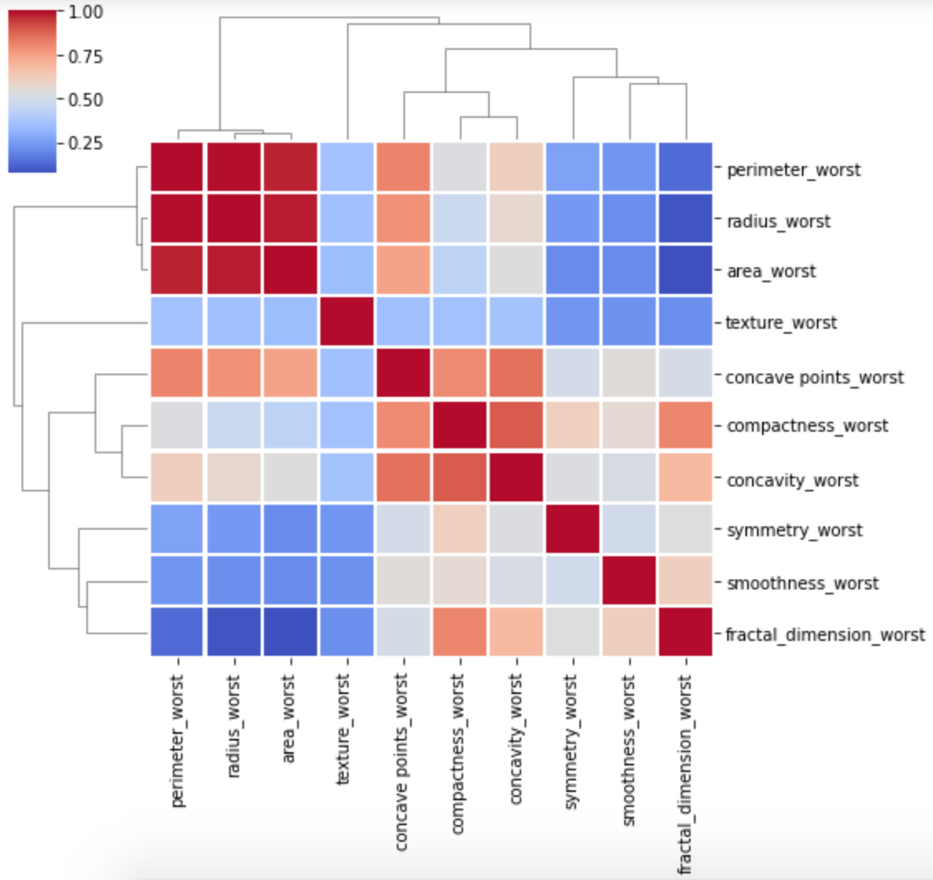
Exploratory data analysis

Slide 9
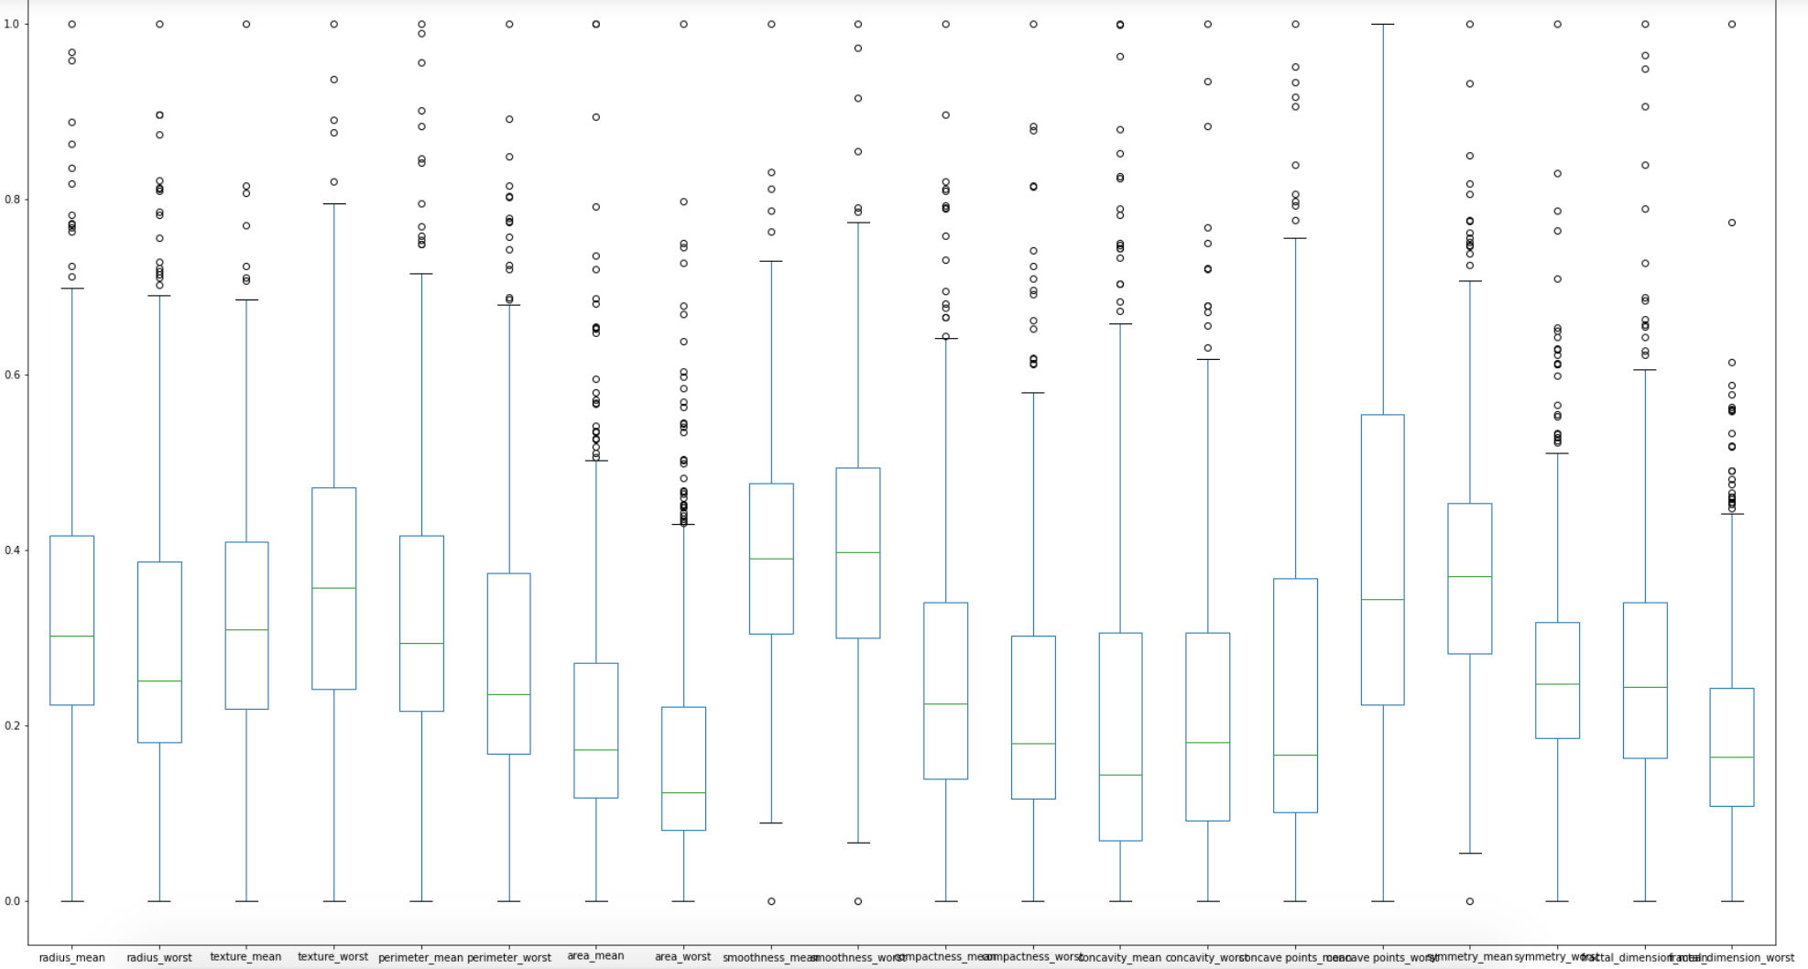
Exploratory data analysis

Slide 10
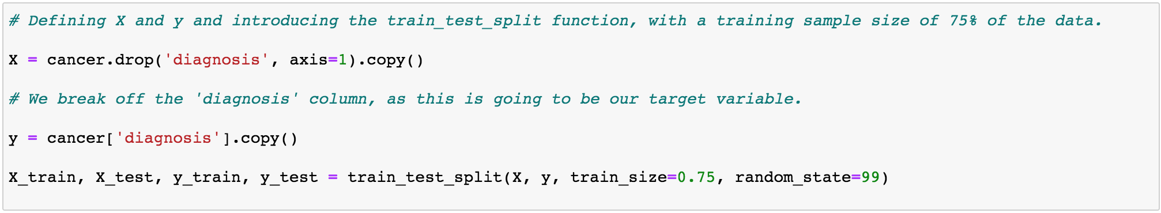
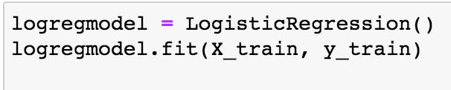
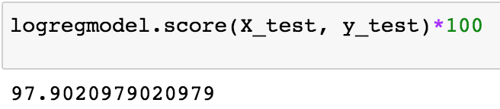
Logistic Regression model
After importing the LogisticRegression, and train_test_split functions from sklearn I set the parameters for the model.
Assigning training and test variables, splitting the dataset
Instantiate and fit the model
How did it perform?
Not bad!

Slide 11
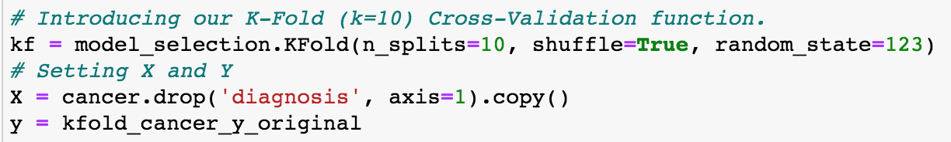
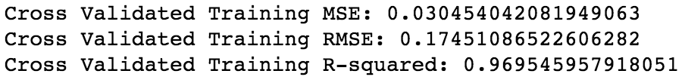
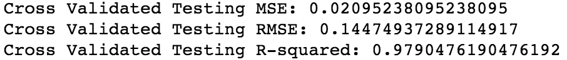
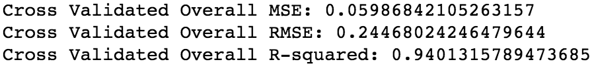
K-FOLD cross validation
To evaluate the reported accuracy of the model, K-fold cross-validation was applied to it and error-scored after k=10 splits. Cross-validation ensures that every observation from the original data gets a chance to appear in both the training and the test set.
The cross-validated RMSE of our testing set is just barely higher than that of the training which suggests that the model slightly underfits the data.

Slide 12
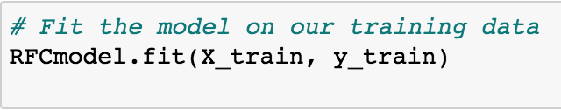
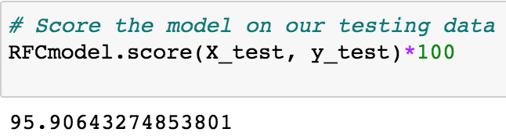
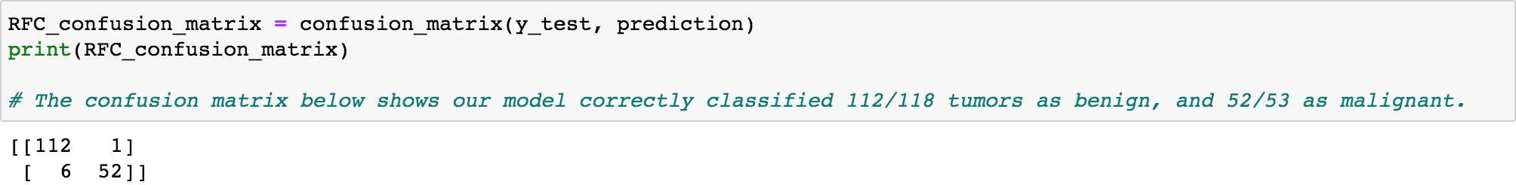
Random forest classifier
After importing the RandomForestClassifier from sklearn I set the parameters for the model. The definitions for ‘X’ and ‘y’ are held from the previous model.
Instantiate the model and split data
Fit the model to the training set
How accurate at classifying in the test set?
Not bad!

Slide 13
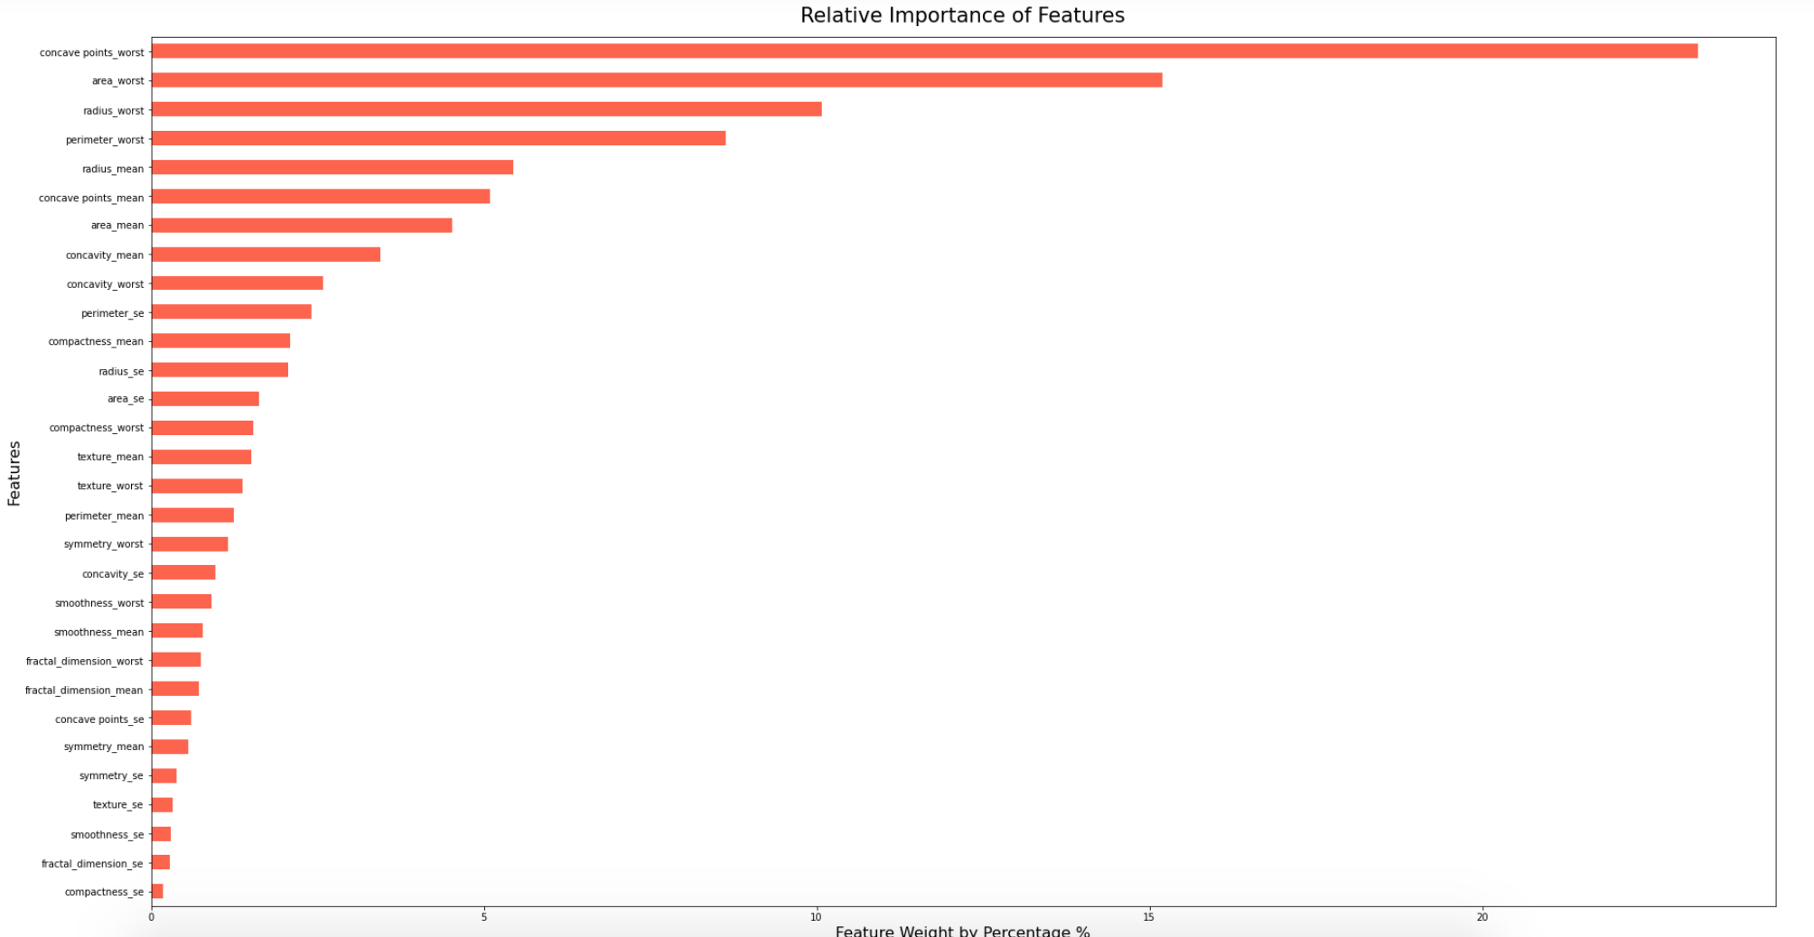
Random forest classifier
One of the benefits on the Random Forest Classifier is that it can be used to determine which features weigh the heaviest in determining the classification in the target variable. In the case of cancer diagnostics, this can alert clinicians to which features in the data should be of most concern.

Slide 14
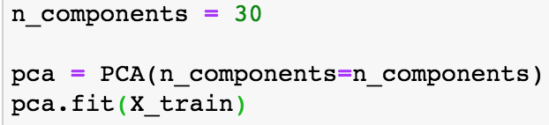
Principal component analysis
This dataset has 30 distinct features that can be used to predict malignancy, however they’re somewhat redundant in the sense that they’re really 10 features expressed 3 different ways. Principal component analysis allows us to see how many components are causing most of the variance in the data.
Define X,y and split the data into training and test sets
Scale the data using StandardScaler
Instantiate and Fit the PCA Model using all 30 features
Like the RandomForestClassifier, PCA has a function to help identify which components are generating most of the variance in the data.
Apply explained_variance_ratio_
Plot

Slide 15
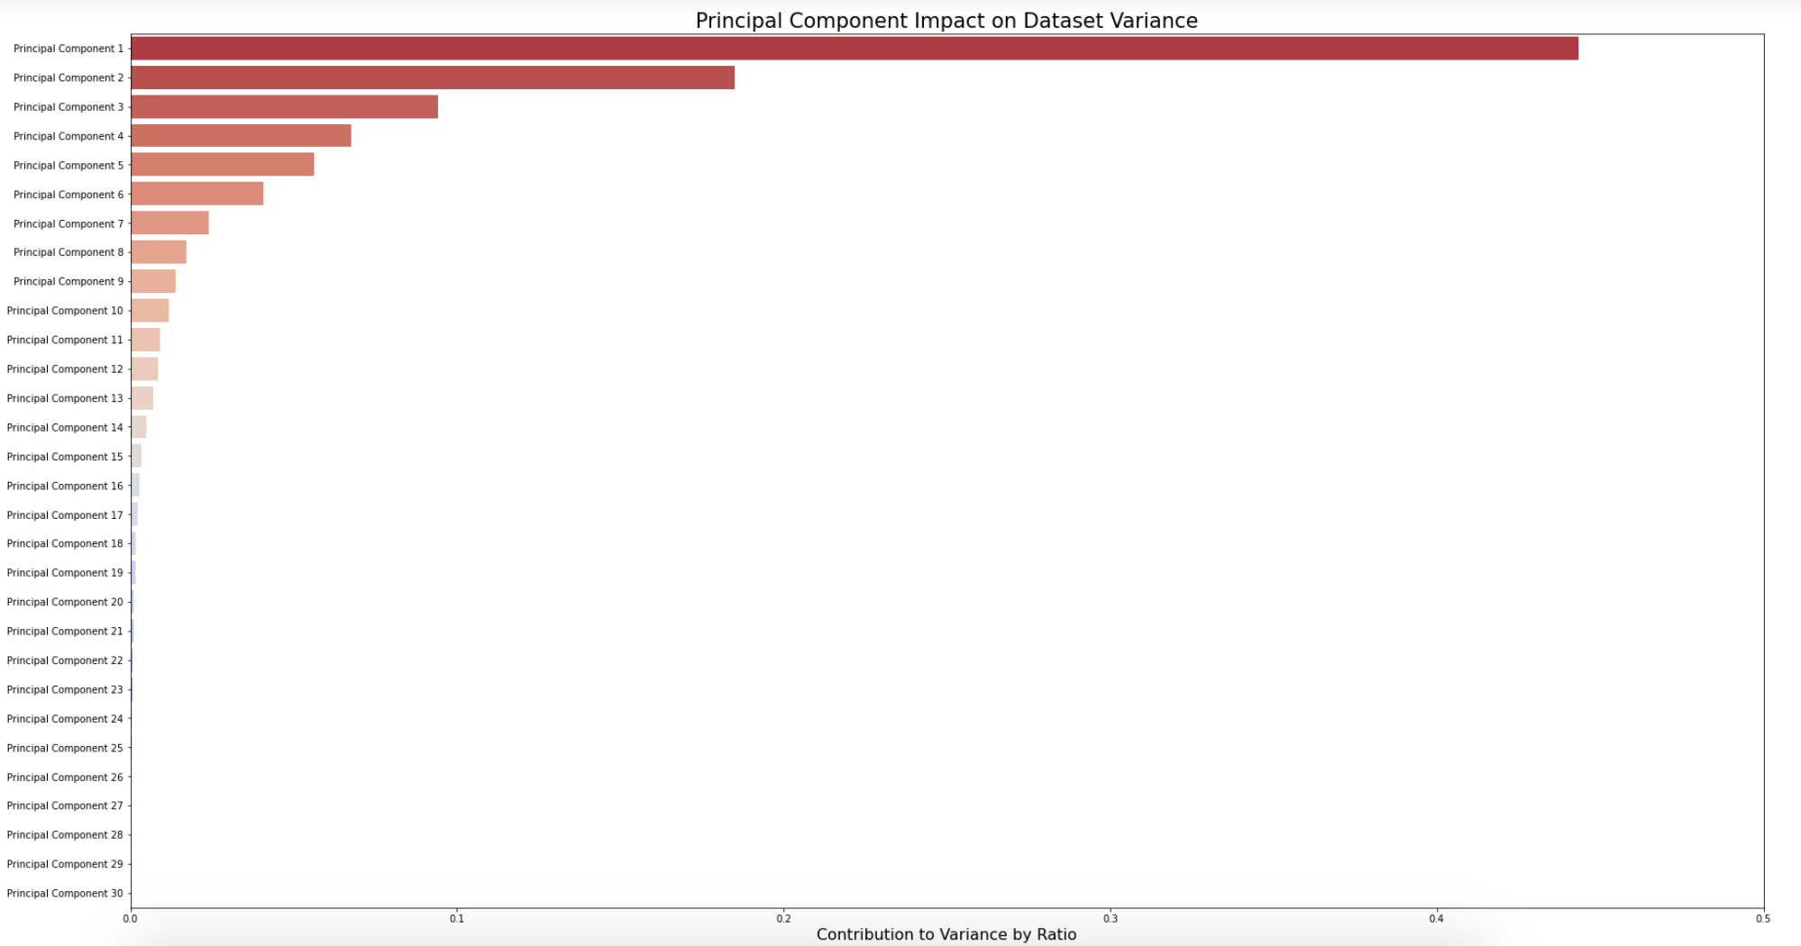
Principal component analysis

Slide 16
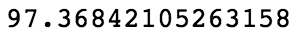
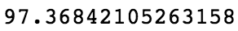
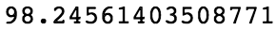
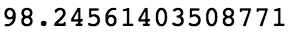
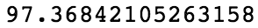
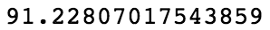
Dimensionality reduction
The takeaway from the PCA plot is that very few components are the source of most of the dataset’s variance. In theory, this means that the number of features in the data could be drastically reduced from 30 and still be able to produce accurate regression models.
Full dataset n_components = 30 | Score
n_components = 20
n_components = 10
n_components = 15
n_components = 5
n_components = 4
n_components = 1
Key Takeaway
It is not necessary to retain all 30 dimensions in this dataset in order to produce an ML model with accurate predictive power. Even reducing to a single PC has the PCA model accuracy at 91%.

Slide 17
Further study opportunities
Diagnostic imaging has come a long way since 1995. Technological advances have presumably created higher resolution images of tumor cell nuclei like the ones in this dataset. If so…
Will more accurate feature measurements show that different physical features have more explanatory power than these models suggest? Do such new datasets exist?
Potential Lines of Effort
Model how much the values of ’worst’ measurements of benign tumors overlap with the average values of malignant cells
Run the same models against the same features but on tumors in different tissue types.
Does ‘concave_points_worst’ have as great of a classification determinacy in other tumor types?

